Slide 1



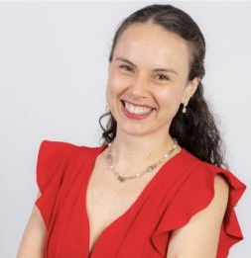

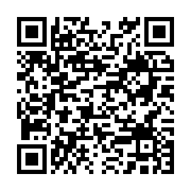



Modalidad híbrida impartida en español
Charla: “Use of Deep Learning Models in Estimating Conversion Probabilities and the Contribution of Communication Channels in Advertising Campaigns”
Resumen de la charla: The wide variety of communication channels through which advertising campaigns can
reach consumers, has made it crucial for marketing specialists to use predictive tools to identify the most effective strategies for budget optimization. This presentation will discuss Marketing Attribution Models based on neural networks, specifically utilizing LSTM architecture. This approach integrates historical customer data to predict conversion rates and determine the most relevant channels for business decisions, enhanced by attention mechanisms. Additionally, an Encoder-Decoder framework is proposed as a modification to the original architecture
Bio: Egresada del bachillerato en Ciencias Actuariales de la Universidad de Costa Rica, y postulante a la Maestría de Métodos Matemáticos y sus Aplicaciones. Durante los últimos cinco años he sido colaboradora del departamento de Data and Services de Mastercard, enfocada en el desarrollo de modelos predictivos y estrategias de prevención de fraude.
Bach. Alexa Sánchez Brenes
Estudiante
Universidad de Costa Rica
05 de marzo 2025
11:00 a. m. Costa Rica
ID: 821 3357 8252 / Acceso: CIMPA
Aula Especializada CIMPA

